Slide 1
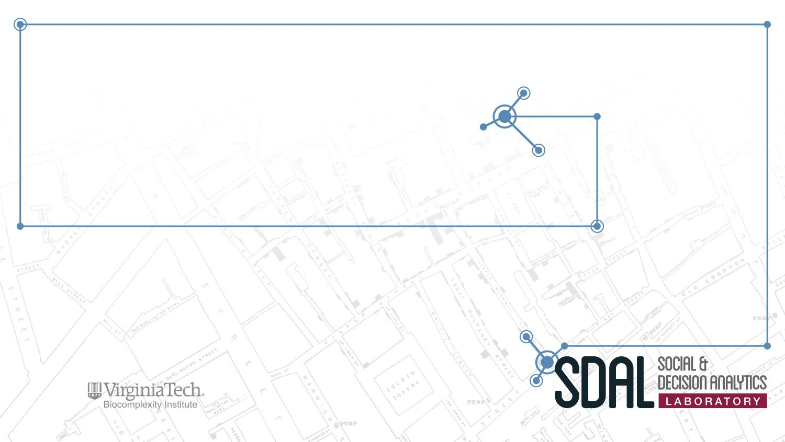
Measuring the Impact of Open Source Software Innovation
SDAL Leads: Stephanie Shipp & Gizem Korkmaz
SDAL Team: Josh Goldstein
Sponsor: National Science Foundation (NSF) –
National Center for Science and Engineering Statistics (NCSES)

Slide 3
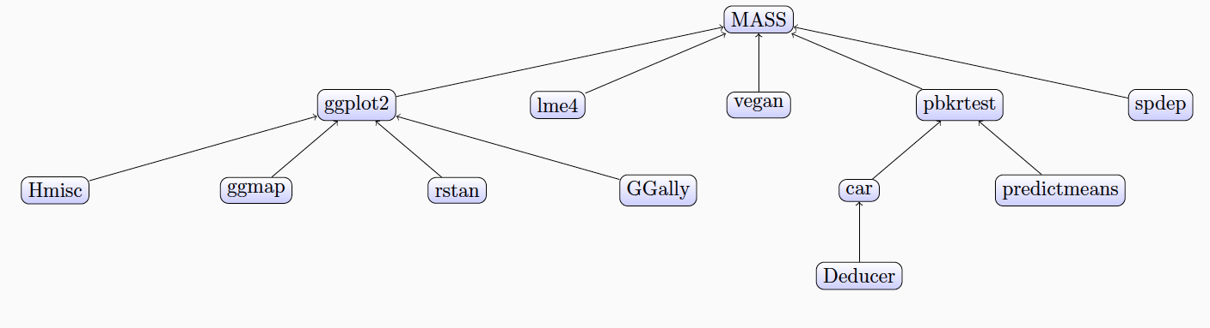
Project Overview
Current NCSES and other economic indicators do not measure the value of goods and services that do not have market transactions,
The goal is to test the feasibility and to develop methods to measure the impact and scope of open source software
Notes:
i.e., they are not captured in surveys nor are in economics measures such as the Gross Domestic Product (GDP).

Slide 4
Research Questions
What sources of data and variables could serve as proxies for measuring attributes and economic value of open source software?
  Counts of OSS, by sector, by technology, by cost, by benefits, by geography
  Attributes, e.g., # citations, #downloaded, # sectors, etc.
How accessible are these data sources and variables from a repeatability and reliability perspective?
What indicators or models could be created to measure attributes and eventually economic value?
What are gaps or limitations in the proposed approaches?

Slide 5
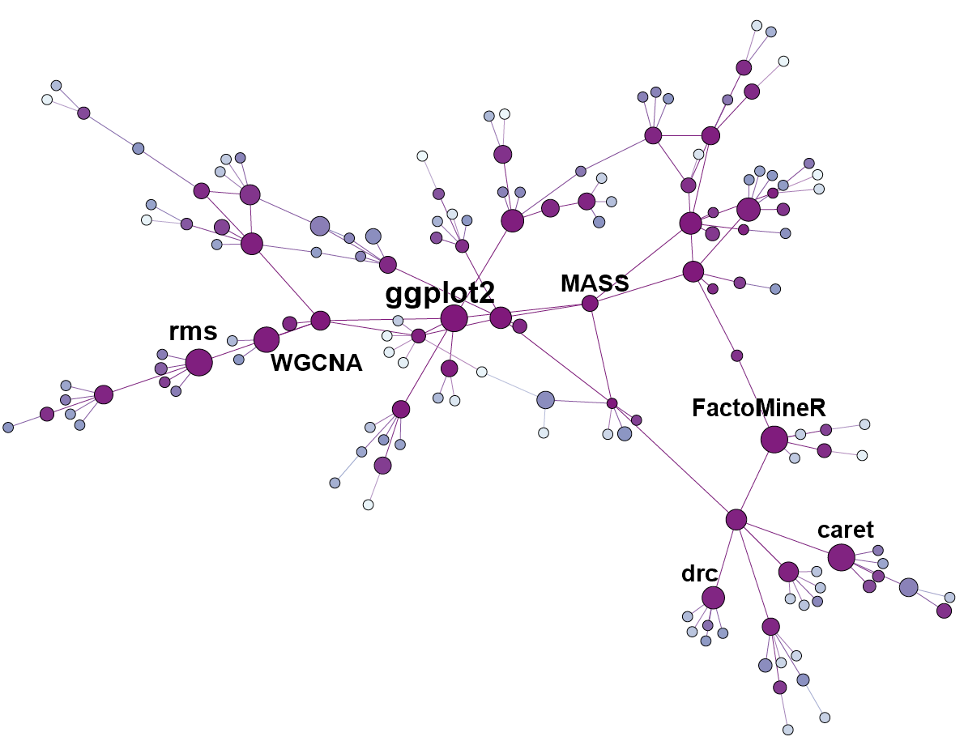
Project Plan
Building on research conducted during Summer 2016, Fall 2016, and Spring 2017
Understanding existing cost/value models for private software
Adapting to open source software
Data collection (webscraping)
Modeling and network analysis

